Slide 1
NODE.JS
(The Backend Of MERN Stack)
Lecture 7

Slide 2
Today’s Agenda
Renaming Files
Deleting Files
Working With Directories Using fs Module
Creating A Directory
Reading Members Of A Directory
Removing A Directory

Slide 3
Renaming files
In addition to reading, writing, and appending data to files, we may also need to rename or delete files using the Node.js FS module.
For renaming a file the fs module provides us a method called rename()

Slide 4
The fs.rename() method
Syntax:
fs.rename(oldPath,newPath,callback)
oldPath: It is a String, Buffer or URL that denotes the path of the file to be renamed
newPath: It is a String, Buffer or URL that denotes the new path of the file to be renamed to
callback: It is a function that would be called when the method has finished its execution. It accepts a single argument representing error

Slide 5
Exercise 14
WAS to rename the file called message.txt in the text_files folder of your app to sandesh.txt.
If renaming is successful then display the message File renamed successfully otherwise display the error .

Slide 6
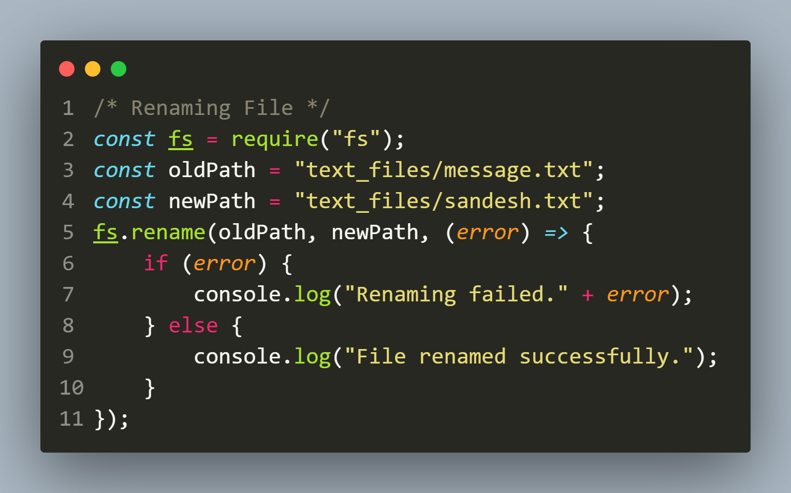
Solution

Slide 7
deleting files
For deleting a file the fs module provides us a method called unlink()
Syntax:
fs.unlink(filePath,callback)
filePath: It is a String, Buffer or URL that denotes the path of the file to be deleted
callback: It is a function that would be called when the method has finished its execution. It accepts a single argument representing error

Slide 8
Exercise 15
WAS to delete the file called message.txt in the text_files folder of your app to sandesh.txt.
If deletion is successful then display the message File deleted successfully otherwise display the error .

Slide 9
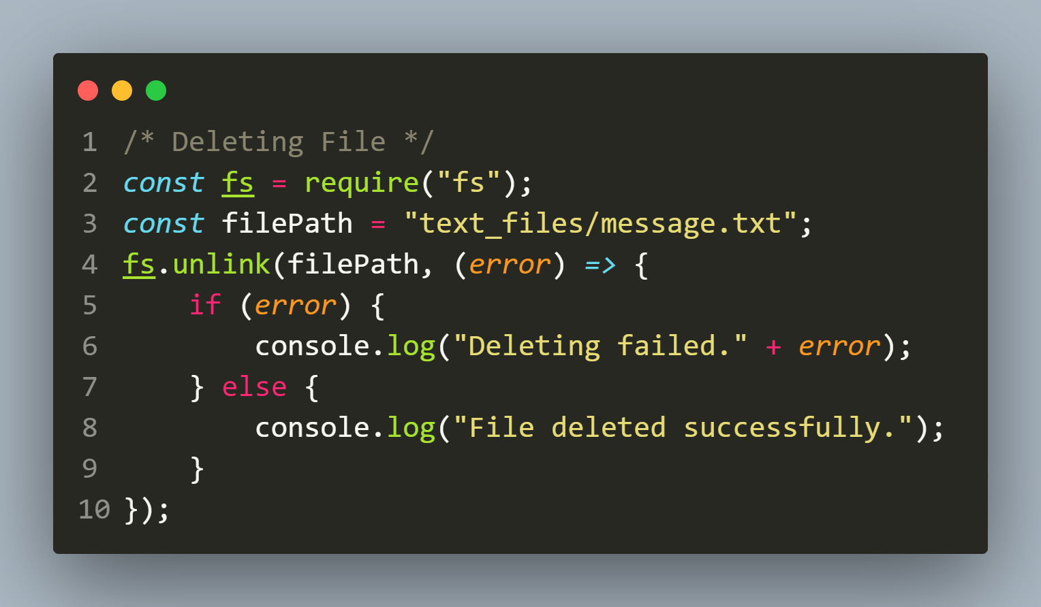
Solution

Slide 10
Working with directories using fs module
The Node.js fs module also allows us to work with directories.
Here, we’ll cover some common methods for creating, reading, and deleting directories:
fs.mkdir()
fs.readdir()
fs.rmdir()

Slide 11
The fs.mkdir() method
The fs.mkdir() method is asynchronous and is used to create directory.
It takes three arguments: the directory path, the options indicating the recursive creation and a callback function that is called when the method is complete.
Syntax:
fs.mkdir(path,options,callback)

Slide 12
The fs.mkdir() method
Syntax:
fs.mkdir(path,options,callback)
path: It is a String, Buffer or URL that denotes the path of the directory to be created.
options: an object containing a property called recursive to indicate whether parent directories are to be created or not. Its default value is false
callback: It is a function that would be called when the method has finished its execution. It takes two parameters:
err: If any error occurred.
path: Prsesent only if recursive is true

Slide 13
Exercise 16
WAS to create a directory called videos in the text_files folder of your app .
If the directory gets created then display the message Directory created successfully otherwise display the error message

Slide 14
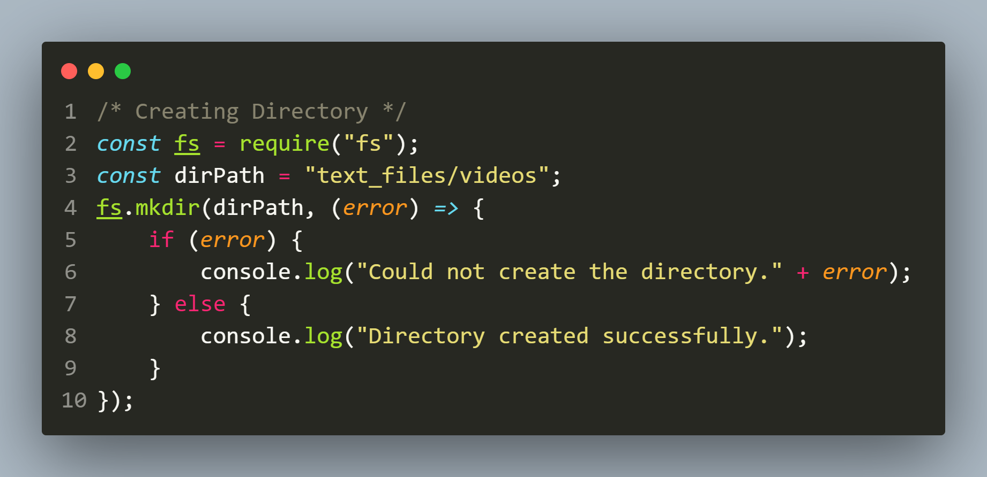
Solution

Slide 15
Creating parent directories
The fs.mkdir() method is able to create a directory only when all the parent directories are present, otherwise it fails.
If we also want to create parent directories along with the child directory then we must pass an object containing the property recursive set to true as the second argument to mkdir()

Slide 16
Exercise 17
WAS to create a directory called videos in the text_files/media folder of your app .
Make sure that all the parent directories are also created if they are not present
If the directory gets created then display the message Directory created successfully otherwise display the error message

Slide 17
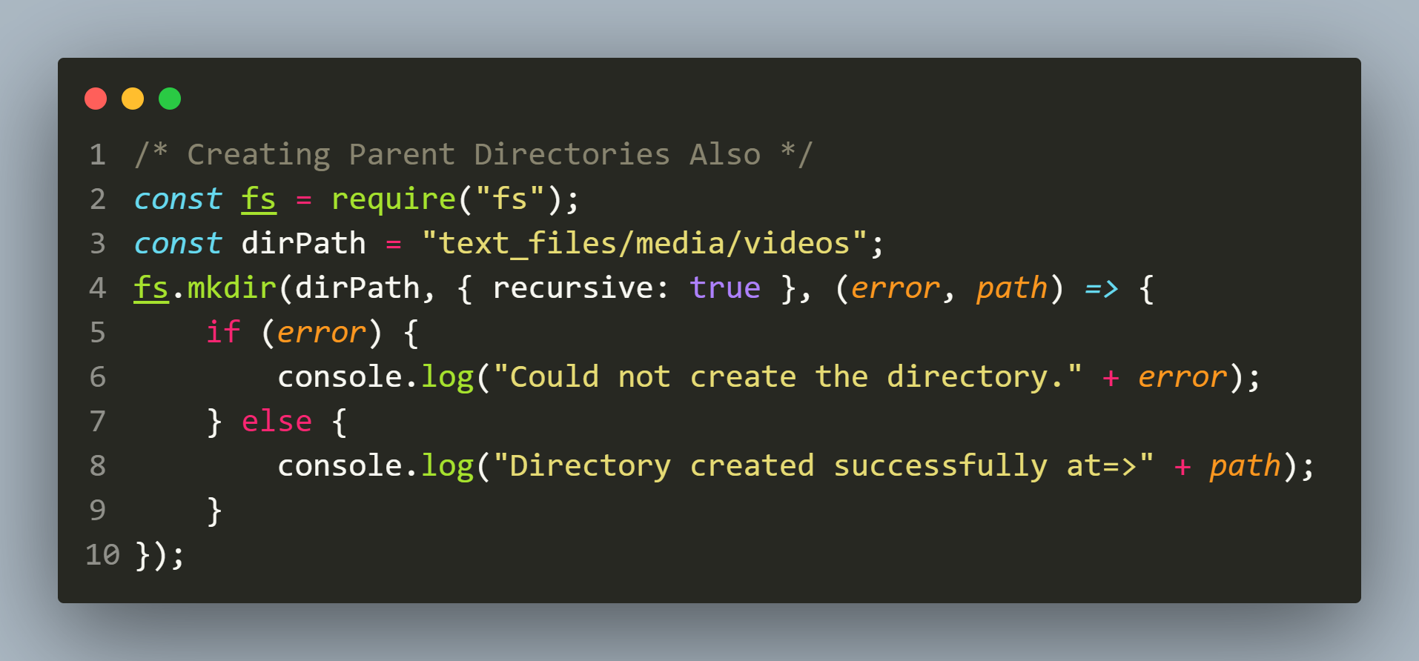
Solution

Slide 18
The fs.readdir() method
The fs.readdir() method is asynchronous and is used to read the contents a directory.
It takes three arguments: the directory path, the options indicating the encoding to be used for filenames to be passed to callback and a callback function that is called when the method is complete.
Syntax:
fs.readdir(path,options,callback)

Slide 19
The fs.readdir() method
Syntax:
fs.readdir(path,options,callback)
path: It is a String, Buffer or URL that denotes the path of the directory to be read.
options: an object which specifies which encoding would be used for the filenames given to the callback argument. The default value is ‘utf8’.
callback: It is a function that would be called when the method has finished its execution. It takes two parameters:
err: If any error occurred.
files: It is an array of files in the directory.

Slide 20
Exercise 18
WAS to display the total number of members in your current working directory as well as their names.
In case of any error display the error message

Slide 21
How to get cwd in node ?
There are two ways of getting the current working directory in Node.js
They are:
__dirname
./

Slide 22
How to get cwd in node ?
__dirname is an environment variable that holds the absolute path of the directory containing the currently executing file.
The ./ gives the current working directory which is the path of the folder where the node command executed.

Slide 23
Can we see the path of ./ ?
Yes we can .
To do this we need to import a module called path which contains a method called resolve().

Slide 24
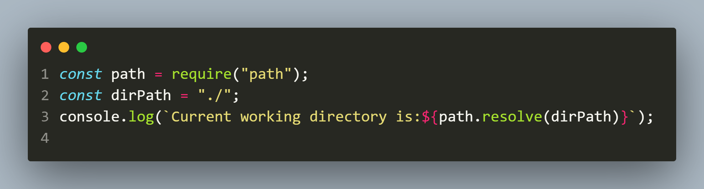
Can we see the path of ./ ?
It receives a string representing a path segment and returns an absolute path

Slide 25
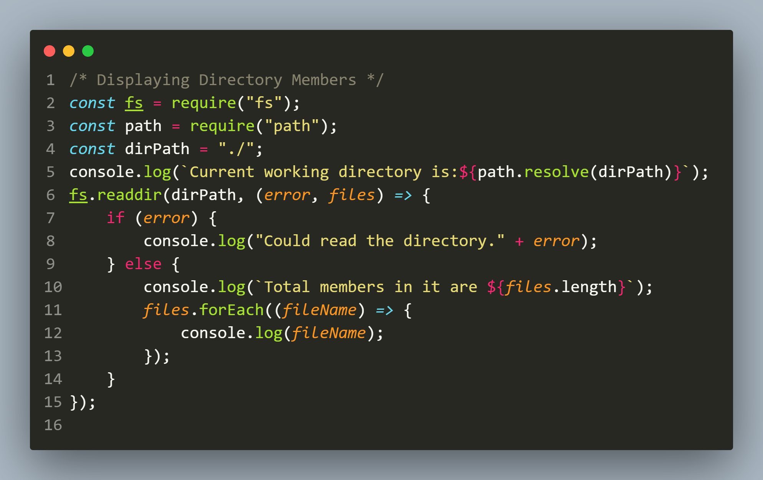
Solution

Slide 26
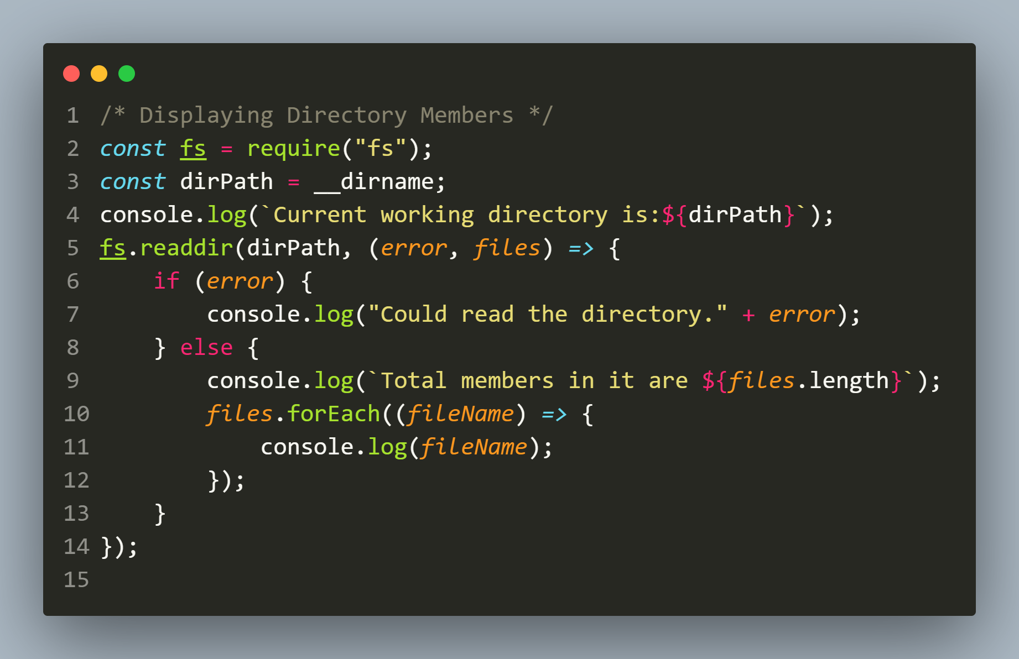
Another Solution

Slide 27
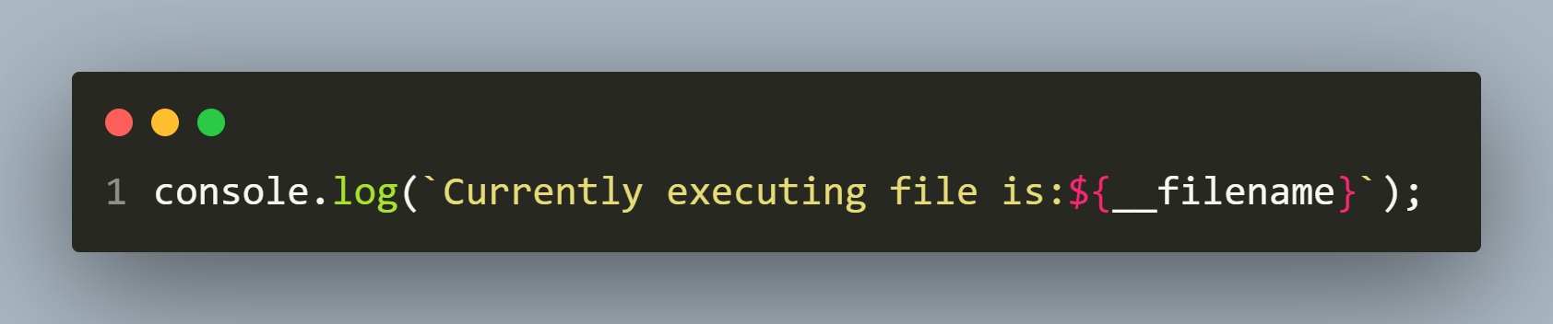
Two more members
There are two more members in Node.js which can be useful at times:
__filename: It is an environment variable which returns the filename of the code which is getting executed. It gives the absolute path of the code file.
Example

Slide 28
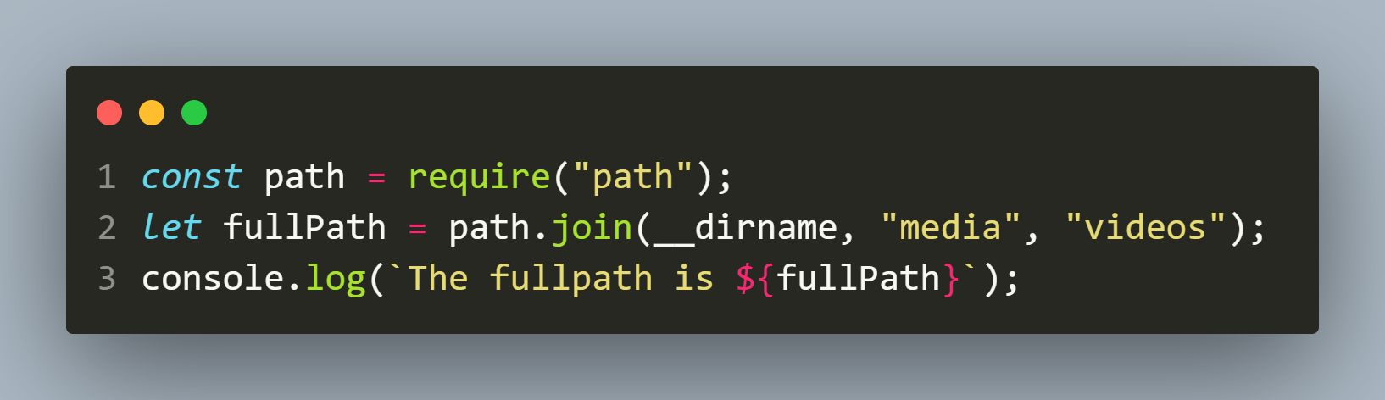
Two more members
join(): This method belongs to path module and used to join number of path-segments using the platform-specific delimiter to form a single path. The path-segments are specified using comma-separated values.
Example

Slide 29
The fs.rmdir() method
The fs.rmdir() method is asynchronous and is used to delete a directory.
It takes three arguments: the directory path, the options indicating the extra parametrs and a callback function that is called when the method is complete.
Syntax:
fs.rmdir(path,options,callback)

Slide 30
The fs.rmdir() method
Syntax:
fs.rmdir(path,options,callback)
path: It is a String, Buffer or URL that denotes the path of the directory to be removed.
options: an object that can be used to specify optional parameters that will affect the operation. It has three properties:
recursive: It is a boolean value which specifies if recursive directory removal is performed.
maxRetries: It is an integer value which specifies the number of times Node.js will try to perform the operation when it fails due to any error. The operations are performed after the given retry delay. This option is ignored if the recursive option is false. The default value is 0.
retryDelay: It is an integer value which specifies the time to wait in milliseconds before the operation is retried. This option is ignored if the recursive option is false. The default value is 100 milliseconds.

Slide 31
The fs.rmdir() method
callback: It is a function that would be called when the method has finished its execution. It takes one parameters called err If any error occurred.

Slide 32
Exercise 19
WAS to delete the directory called text_files in your app
In case of any error display the error message

Slide 33
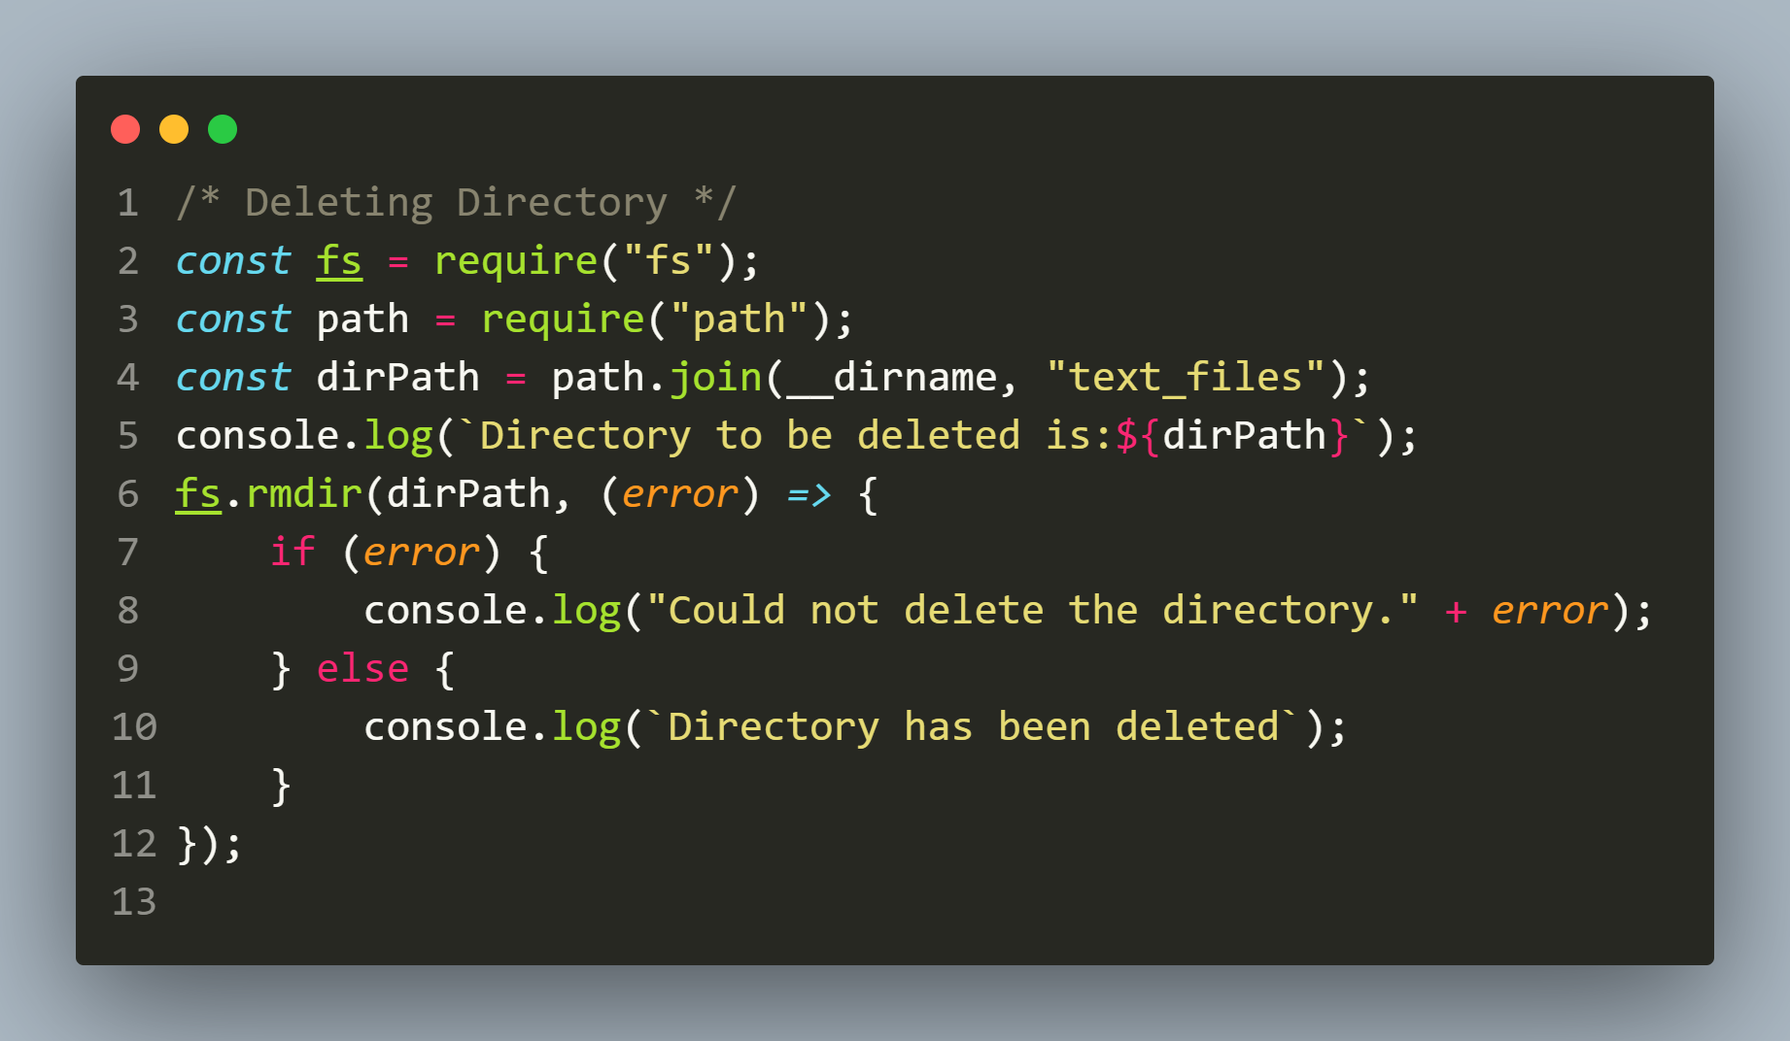
Solution

Slide 34
Exercise 20
WAS to recursively delete the directory called text_files in your app .
That is , if the directory text_files has some subdirectories or files then they too must be deleted .
In case of any error display the error message

Slide 35
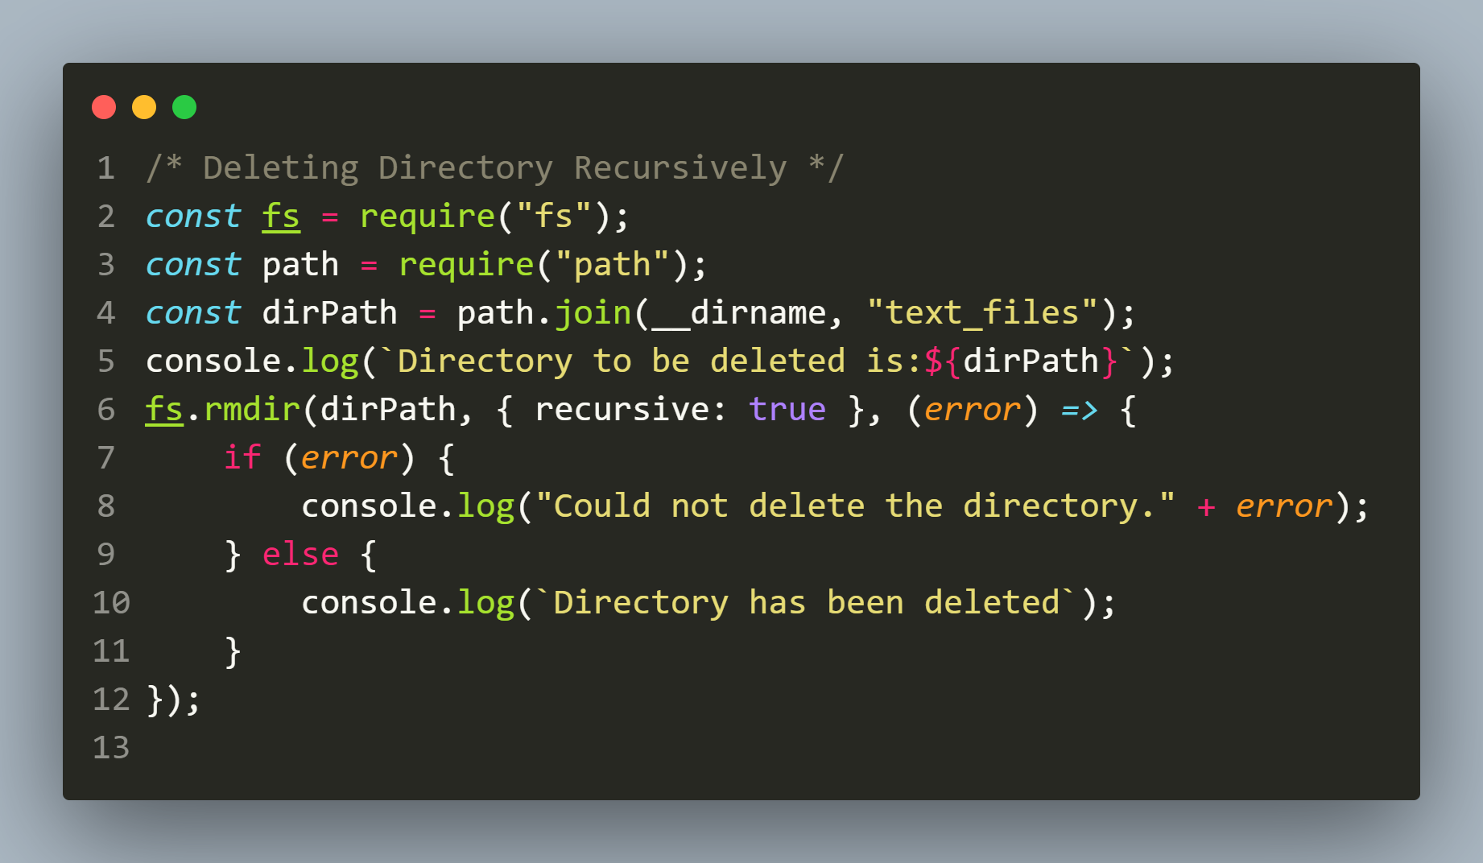
Solution

